Slide 1
Securing data hiding images using steganography
CAPSTONE PROJECT
Presented By: P.Manideep
Student Name : P.Manideep
College Name & Department :SCSVMV University

Slide 2
OUTLINE
Problem Statement
Technology used
Wow factor
End users
Result
Conclusion
Git-hub Link
Future scope

Slide 3
Problem Statement
The problem of secure data hiding in images using steganography involves embedding confidential information within digital images without detection, ensuring both the integrity and confidentiality of the hidden data. Traditional methods may be vulnerable to attacks or may compromise image quality, necessitating the development of robust algorithms that can effectively conceal data while resisting extraction attempts. The challenge lies in balancing the imperceptibility of the hidden data with the capacity and security of the steganographic technique employed.

Slide 4
Technology used
Python
OpenCV
OS
String Manipulation
Image Processing
Steganography
Basic Cryptography
Pixel Manipulation
File Handling

Slide 5
Wow factors
Simple Yet Effective Character-Based Encoding
Password-Based Decryption
Minimal Image Distortion
No Additional Software Dependencies
Platform Independence & Open source Implementation
Interactive Message Encoding & Decoding
Easily extendable for Future Enhancements

Slide 6
End users
Government Agencies for Secure Communication
Journalists & Whistleblowers for Confidential Data Exchange
Military & Intelligence Services
Corporate Sector for Protecting Sensitive Information
Individuals Concerned with Personal Data Security

Slide 7
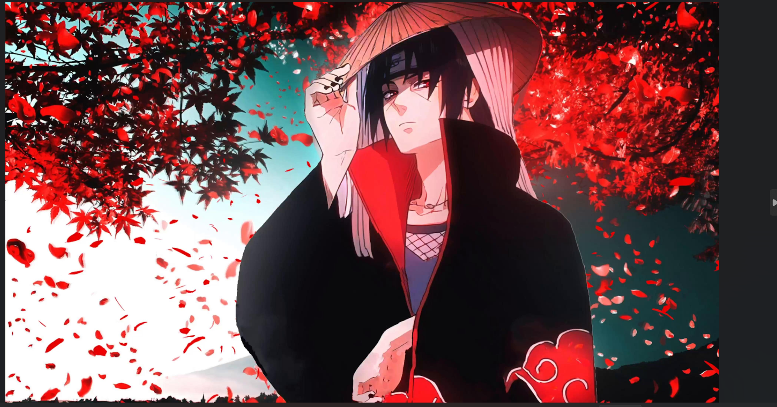
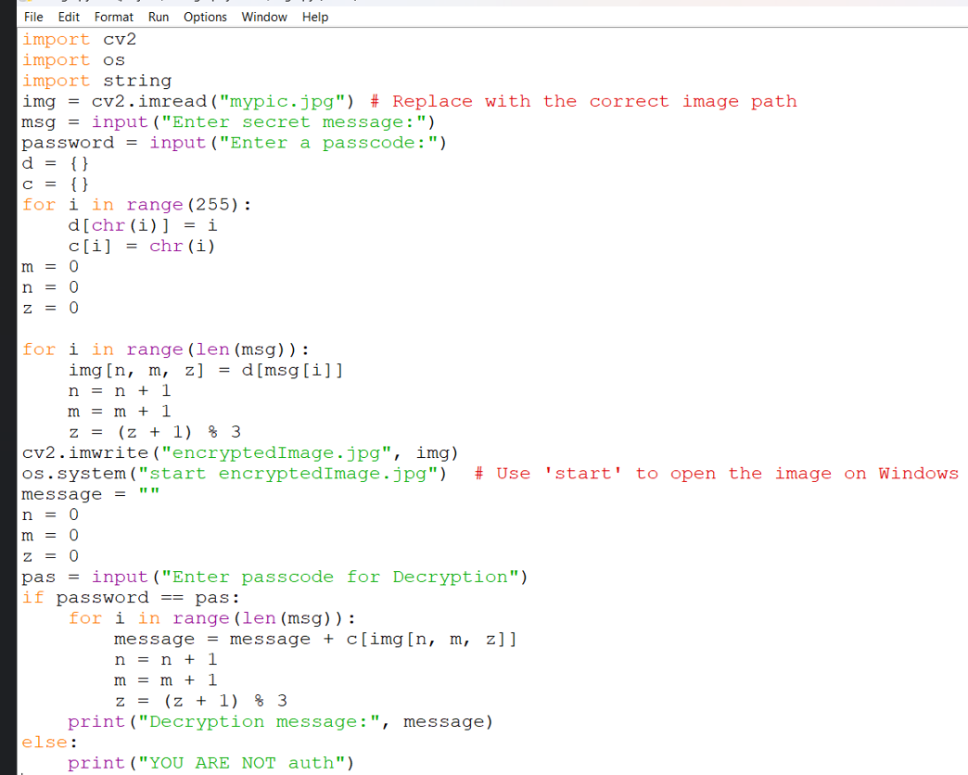
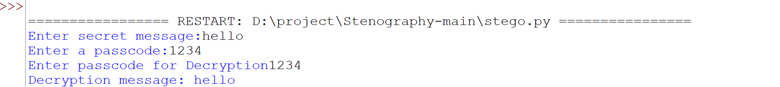
Results

Slide 8
Conclusion
This project successfully demonstrates the use of steganography for secure communication. By leveraging image-based data hiding techniques, it provides a covert method of transmitting sensitive information while maintaining the integrity of the cover image. The system ensures data security while offering a simple and efficient implementation for real-world applications.

Slide 9
GitHub Link
https://github.com/Manideep-07/aicte_project.git

Slide 10
Future scope(optional)
Integration with Advanced Encryption Standards
Support for Audio & Video Steganography
Cloud-Based Secure Data Transmission
AI-Based Image Selection for Optimal Data Hiding

Slide 11
THANK YOU

